Slide 1
Image Analysis Naly Torres May 1st, 2023

Slide 2
Types of questions we can ask with microscopy
Types of molecules
Histology (for tissues)
Bacteria
RNA
Protein
Live imaging systems

Slide 3
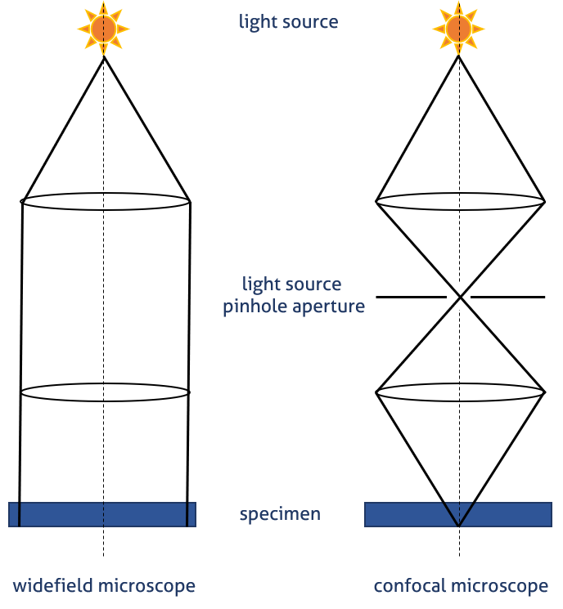
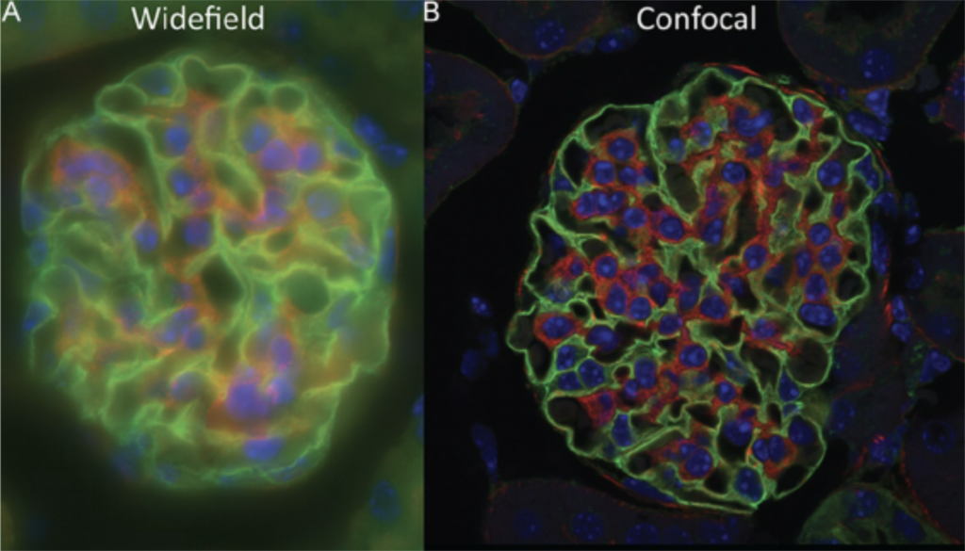
Types of microscopy
Wide field vs confocal
deconvolution

Slide 4
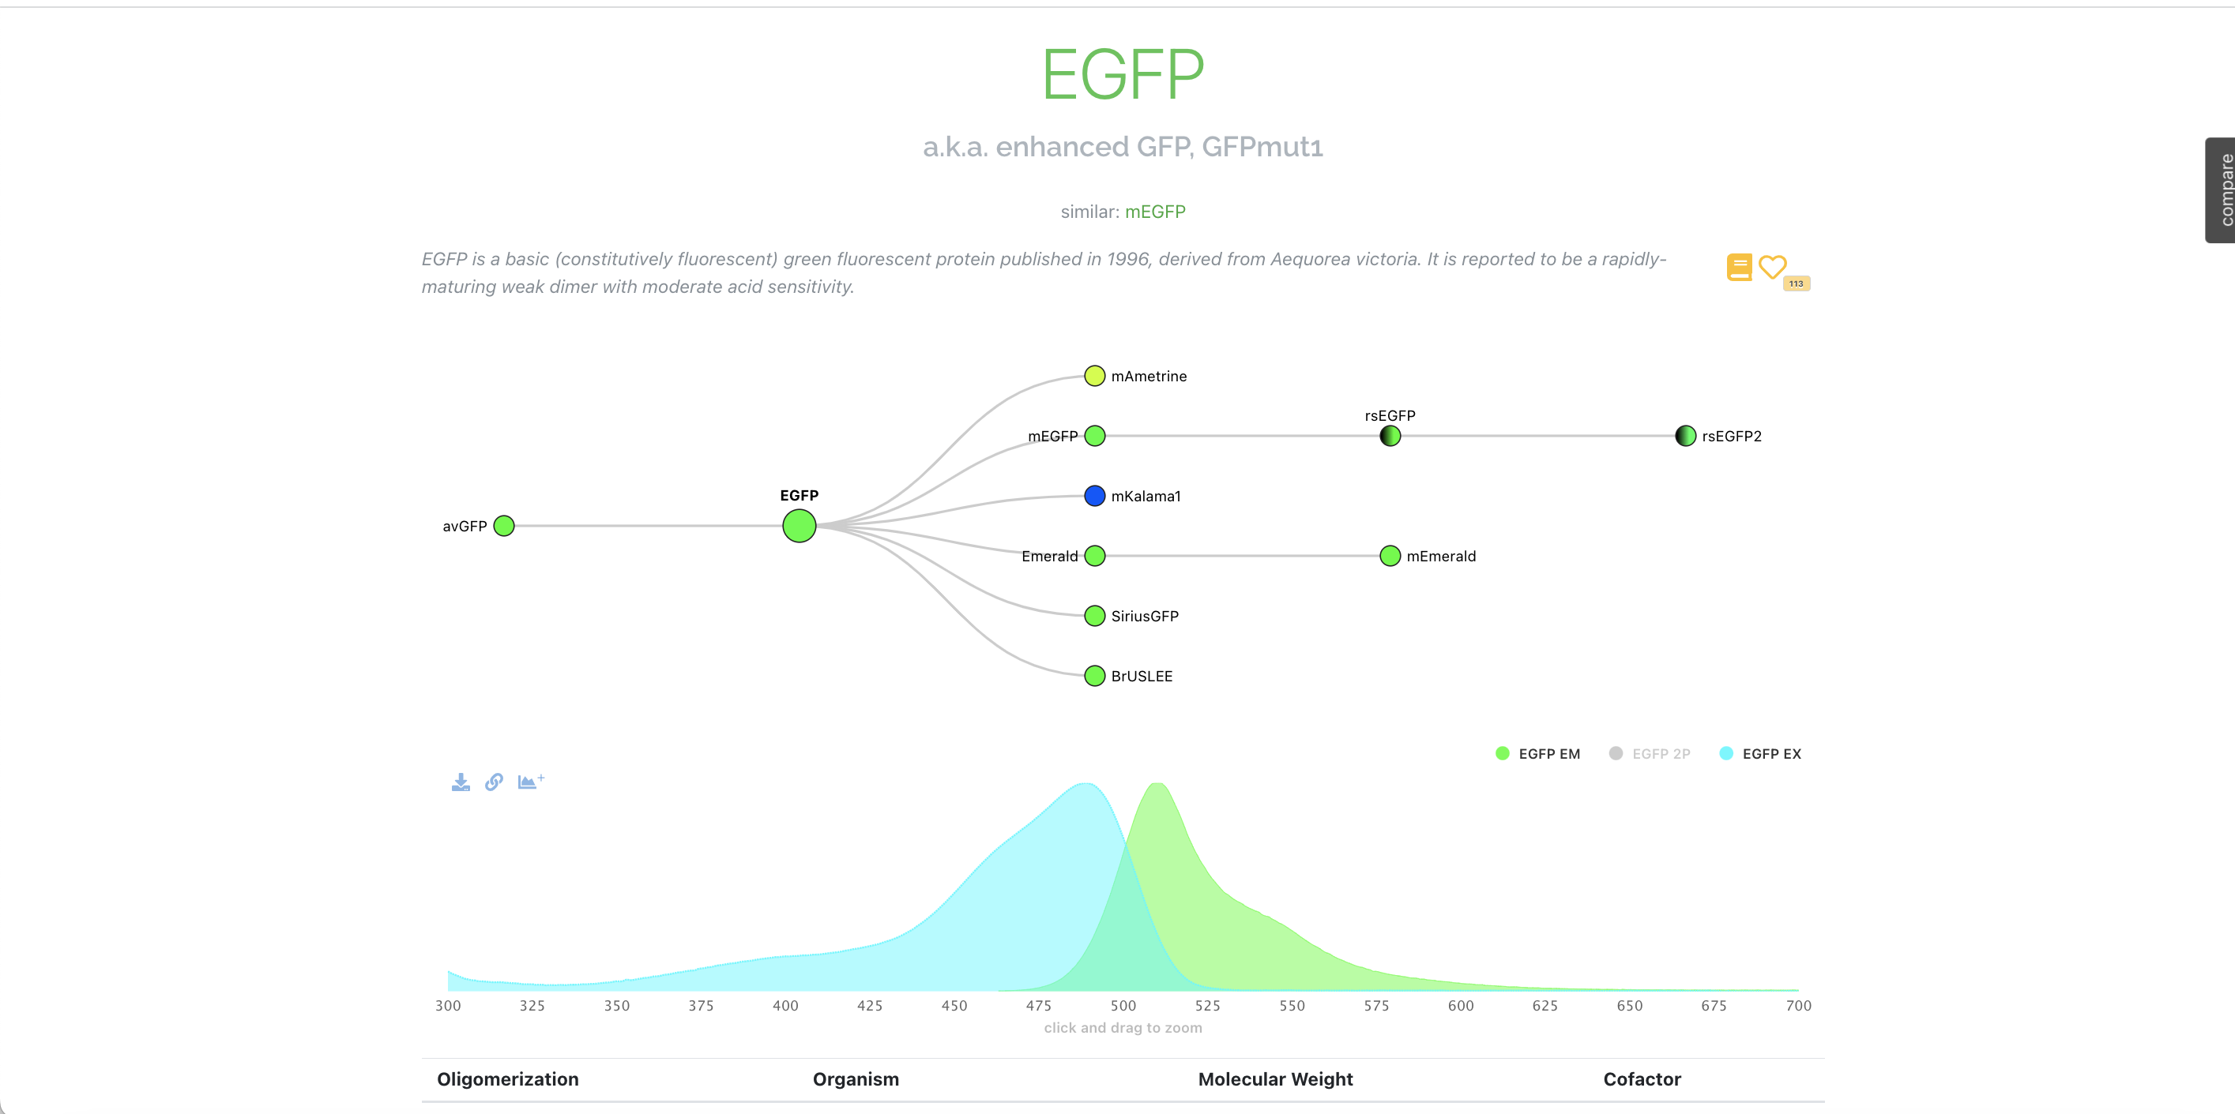
Fluorophores – emission/excitation
Fpbase

Slide 5
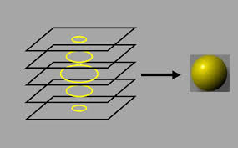
Z-stacks
Z-stacking (also known as focus stacking) is a digital image-processing method which combines multiple images taken at different focal distances to provide a composite image with a greater depth of field (e.g., the thickness of the plane of focus) than any of the individual source images.

Slide 6
FIJI
Overview of software

Slide 7
File formats
R3D.dv – non-deconvolved
D3D.dv – deconvolved
Log.txt – metadata
.dv – slices in Z. TIFF related file
REF.dv – differential contrast image

Slide 8
In-class exercise #1
Find images in GitHub
Download files
Follow Naly -> process an embryo image
Do it yourself on Jess’s image

Slide 9
In-class exercise #2
Making a 3D projection
How to write a macro
-To turn in: Write your own macro & its README.txt file
BC-665B | 001 | Adv Topics: Modern Methods

